Slide 1
Advanced higher Graphic communication
Technical Graphics - File Formats

Slide 2
introduction
In this lesson you will learn about the different Technical Graphic File Formats and where they commonly be used.
The following is a list of the file formats your need to have a knowledge of.
.STL
.DXF
.DWG
.VRML
.3DS

Slide 3
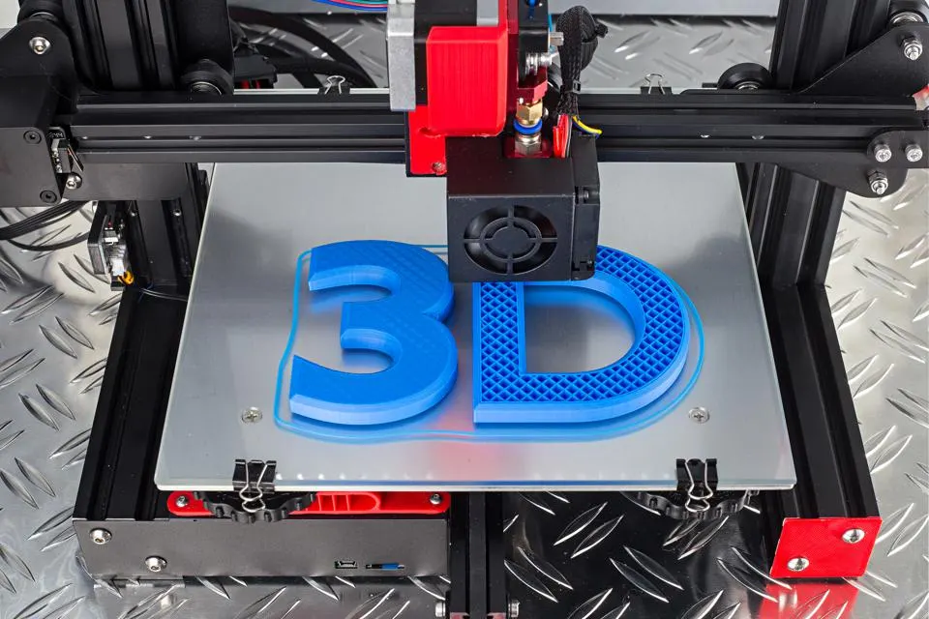
Standard tessellation language/stereo lithography file format (STL)
What is special or different about this file?
This file format is supported by many other software packages; it is widely used for rapid prototyping, 3D printing and computer-aided manufacturing. STL files describe only the surface geometry of a three-dimensional object without any representation of colour, texture or other common CAD model attributes.

Slide 4
Direct exchange format (dxf)
What is special or different about this file?
Files that contain the .dxf file extension contain CAD vector image files. The DXF file format is a 2D drawing format similar to the DWG file format, but DXF files are ASCII based and are therefore more compatible with other computer applications.
What is it used for?
DXF files are commonly used in 2D manufacture such as plasma cutting and laser cutting.

Slide 5
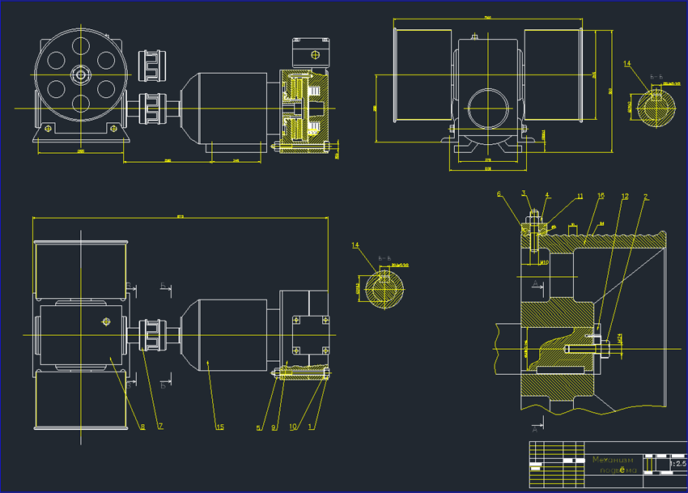
Drawing format (Dwg)
What is special or different about this file?
The native file format for AutoCad data files is .dwg. It contains all the pieces of information a user enters, such as: Designs, Geometric data, Text, Maps, Photos etc.
What is it used for?
The .dwg file format is one of the most commonly used design data formats, found in nearly every design environment. It signifies compatibility with AutoCad technology.

Slide 6
Virtual reality modelling language (VRML)
What is special or different about this file?
VRML is a language for describing three-dimensional image sequences and possible user interactions to go with them.
What its it used for?
Using VRML you can build a sequence of visual images into Web settings with which a user can interact by viewing, moving, rotating and otherwise interacting with an apparently 3D scene. For example, you can view a room and use controls to move the room as you would experience it if you were walking through it in real space.

Slide 7
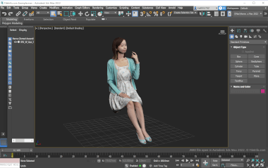
3D studio (3ds) files
What is special or different about this file?
A 3DS file is a file format used by 3D modelling, animation and rendering software. The format has become industry standard for transferring models between 3D programs, or for storing models for 3D resources. It contains one or more 3D models, including wireframes, textures, lighting effects, shading, animations, and other 3D design elements.
What is it used for?
The 3DS format aims to provide an import/export format, retaining only essential geometry, texture and lighting data.

